Slide 1
Youtube Data Harvesting & Warehousing
Devadath G Nair

Slide 2
Introduction
This is a Streamlit app tailored for accessing and analyzing data from diverse YouTube channels. Key functionalities include data retrieval (subscribers, video count, etc.) via the Google YouTube Data API, storing in MongoDB as a data lake, seamless migration from MongoDB to SQL, and enabling search and retrieval through SQL queries.
GitHub Link : https://github.com/DevadathGNair/Youtube_Data_Harvesting_and_Warehousing/tree/main

Slide 3
Libraries Imported
The following are the necessary Libraries imported for the project:
import streamlit as st
from streamlit_option_menu import option_menu
import pymongo
import pandas as pd
from googleapiclient.discovery import build
import mysql.connector
import re
import plotly.express as px

Slide 4
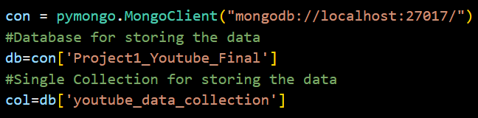
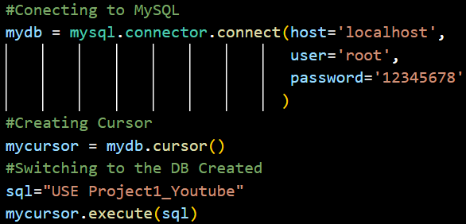
Creating DB Connection
The database connection was established to both MySQL and MongoDB

Slide 5
Creating YT Connection
The connection was established to initialize the YouTube API service using the API key.
api_key="#Provide the API Key"
youtube = build('youtube', 'v3', developerKey=api_key)

Slide 6
Data Extraction using Youtube API
The required data was extracted using youtube data api.
This is the first main step.
In the data extraction phase there were mainly 5 functions written. These include:
def channel_details(channel_id) : To get channel data when a channel id is provided.
def video_id(p_id): Function to return all video ids from the playlist id passed as argument(uploads playlist).
def video_details(v_id): To get video data using video id from Video reference
def comment_details(v_id): To get the comment data when video id is passed

Slide 7
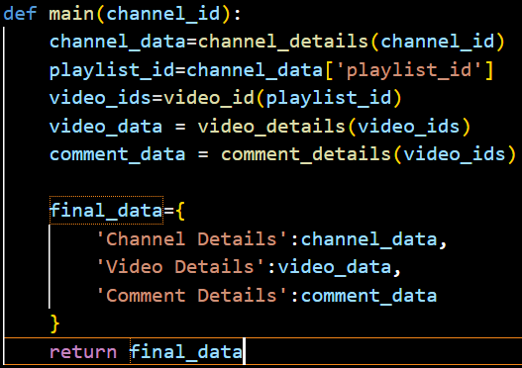
Data Extraction using Youtube API
Now comes the last function for data extraction to call all the above functions and return a combined data in JSON format

Slide 8
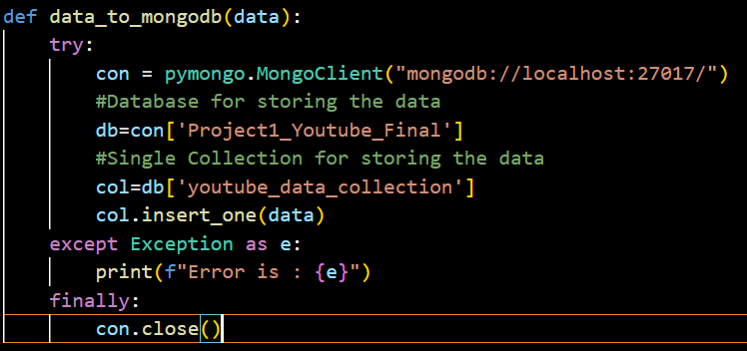
Data Warehousing
Initially the extracted data is inserted to MongoDB using the following function:

Slide 9
Data Warehousing
Initially the extracted data is inserted to MongoDB using the following function:

Slide 10
Data Fetching & Insertion to MySQL
Initially 3 tables were created in MySQL for channel, video and comment data.
We then fetch the data from MongoDB and then transform them to dataframes.
def get_df(channel_name): Function to return three data frames for channel, video and comment data.
The data in data frames are of string type. We then need to transform the data to the required datatype.

Slide 11
Data Fetching & Insertion to MySQL
Created 3 functions to preprocess the data in the data frames and store them in appropriate tables created in the MySQL.
def ch_df_to_sql(channel_df): Function to preprocess and store the channel data in sql channel table
def v_df_to_sql(video_df): Function to preprocess and store the video data in sql video table. Here, I had to convert the duration to int using regex.
def ct_df_to_sql(comment_df): Function to preprocess and store the comment data in sql comment table.

Slide 12
Data Fetching & Insertion to MySQL
After this, I created a main function function to migrate the data from mongodb to mysql.
def get_cnames(): Function to return the channel names from MongoDB.
def main_migration(channel_name): Main Function to migrate data from MongoDB to MySQL when a channel name is given as input

Slide 13
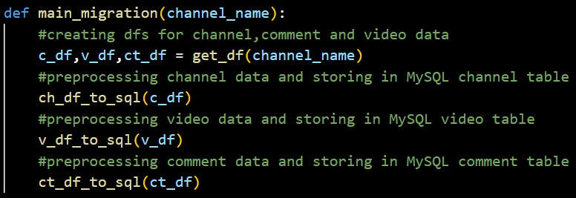
Data Fetching & Insertion to MySQL
def main_migration(channel_name):

Slide 14
Final Part I : Querying using SQL
Once the data was successfully stored to MySQL, with the help of MySQL queries, the solutions to the 10 problems asked were displayed.
Here the outputs were displayed as data frames.
Graphs were also plotted using Plotly wherever it was relevant

Slide 15
Final Part II : Streamlit
Once all the backend procedures were done, the frontend was done using streamlit.
The app was integrated with streamlit which created a beautiful UI.

Slide 16
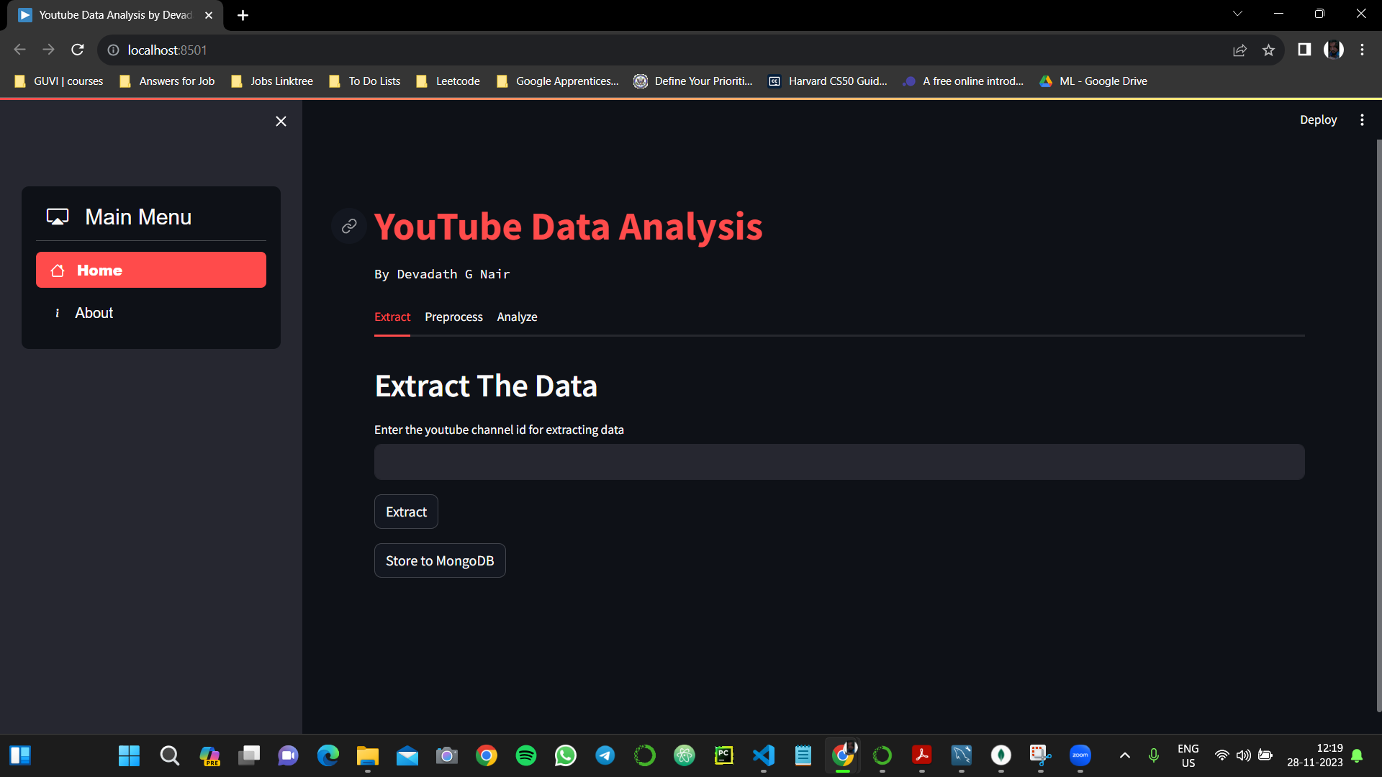
Result

Slide 17
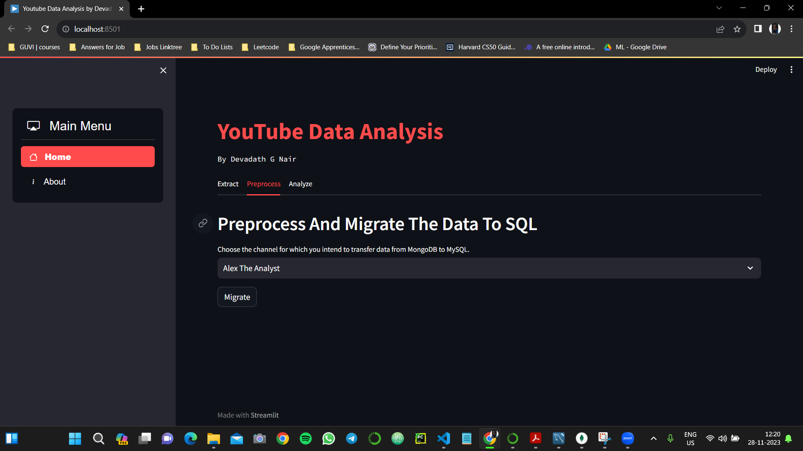
Result Cont.

Slide 18
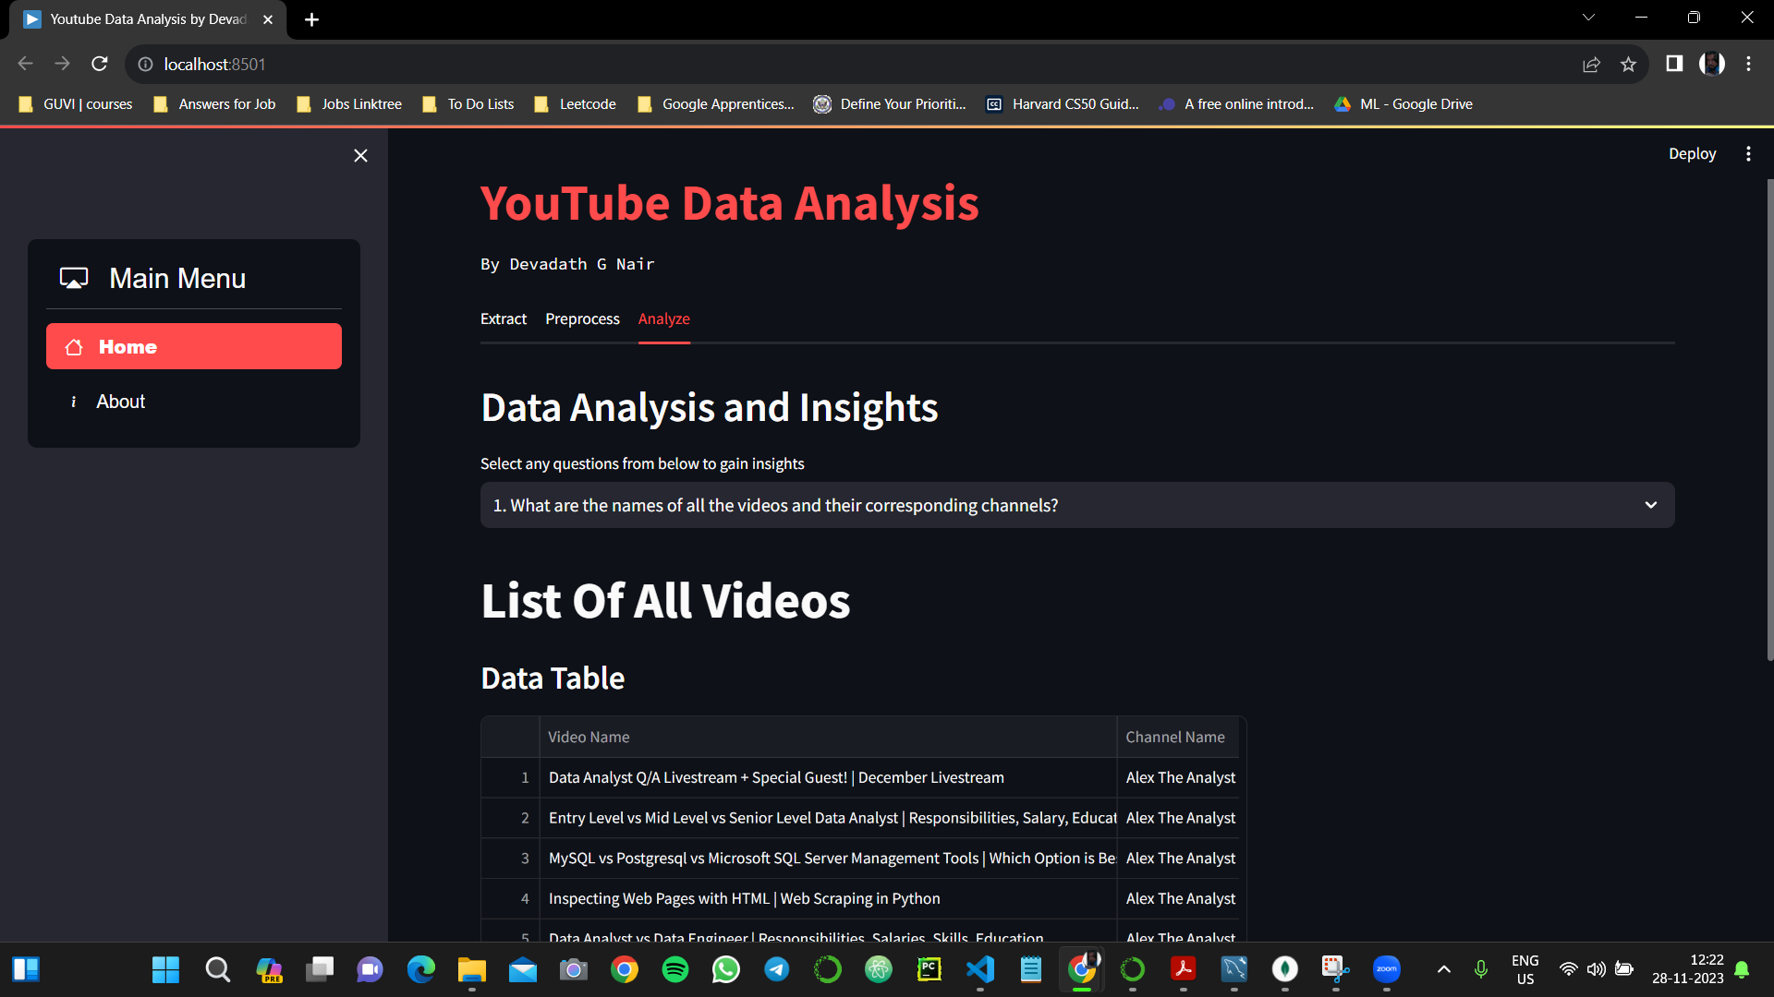
Result Cont.

Slide 19
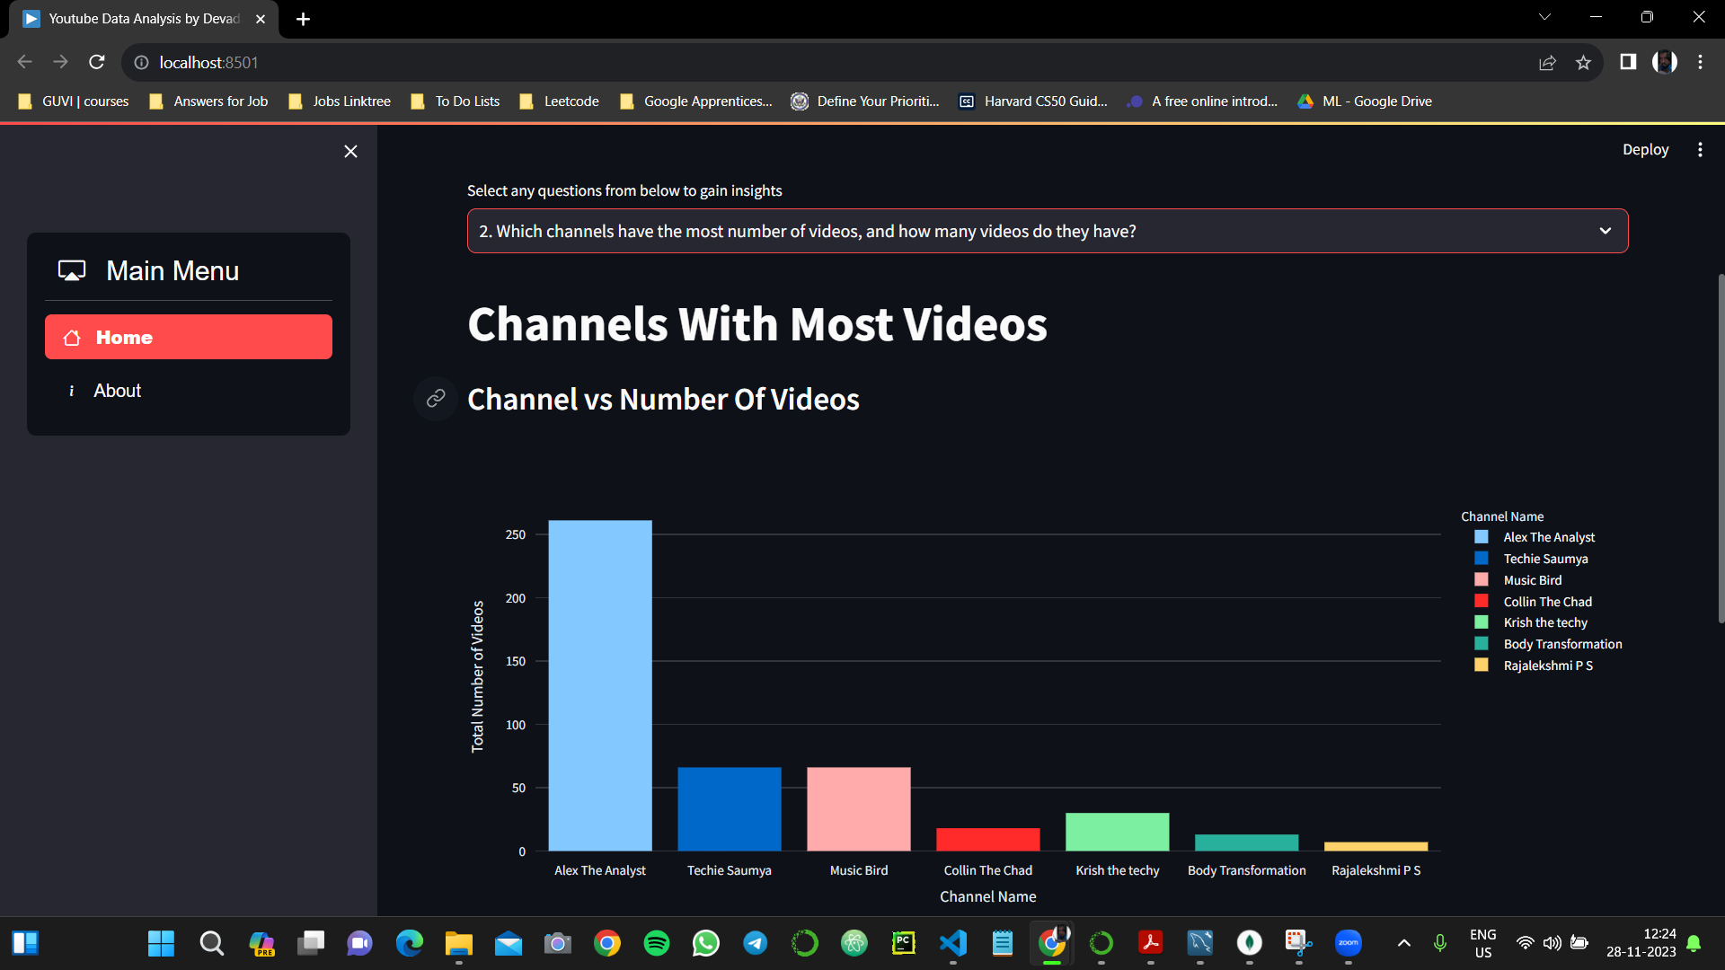
Result Cont.

Slide 20
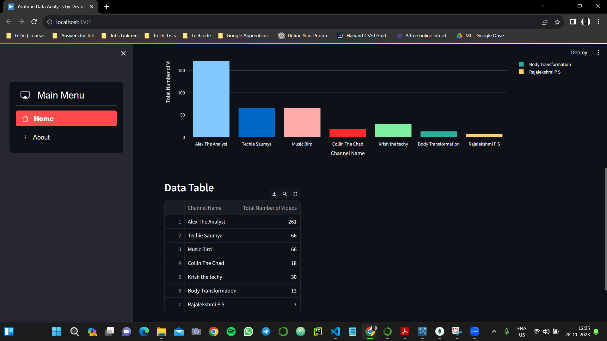
Result Cont.

Slide 21
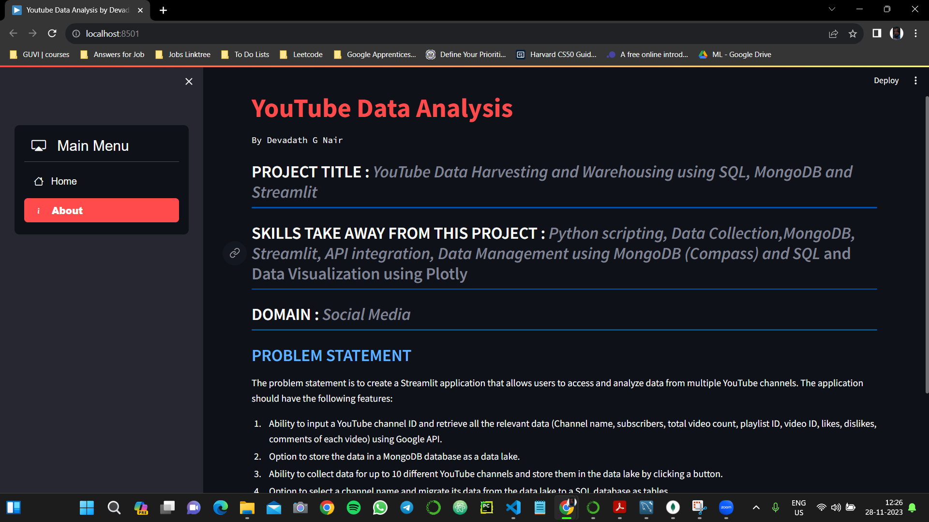
Result Cont.

